Slide 1














DESIGN AND ANALYSIS OF ALGORITHM
GROUP PROJECT
OPTIMAL INVENTORY MANAGEMENT PROJECT
IZWAN ADAM ANAS

Slide 2

PROJECT OVERVIEW
Scenario: Retail store inventory management.
Objective: Balance inventory levels to meet demand, minimize costs, and optimize operations.

Slide 3
IMPORTANCE OF OPTIMAL INVENTORY MANAGEMENT
Customer Satisfaction: Ensuring products are available.
Cost Efficiency: Minimizing holding costs and stockouts.
Operational Efficiency: Effective planning and forecasting.

Slide 4
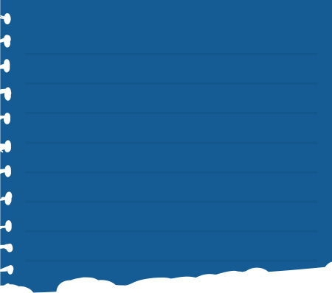
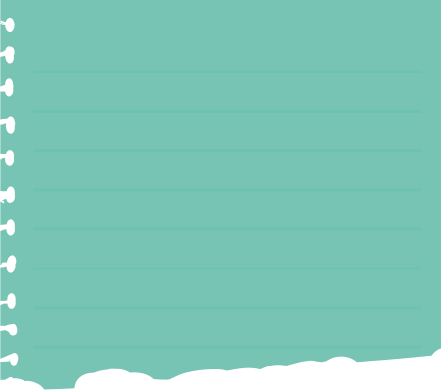
PROBLEM SPECIFICATION
MAIN OBJECTIVE
CONSTRAINTS
Lead time, safety stock, daily demand variability.
Determine optimal inventory levels over time.

Slide 5

ALGORITHM SELECTION
Dynamic Programming (DP):
Strengths: Handles overlapping subproblems and optimal substructure.
Suitability: Efficiently computes minimum costs and restocking plans.
Comparison: Greedy, sorting, and divide-and-conquer not suitable due to future dependencies and lack of optimal substructure.

Slide 6
ALGORITHM DESIGN
State Representation: DP table (day, currentStock) for minimum cost.
Transition: Decision-making based on costs (holding, stockout, restocking).
Implementation: Java program using InventoryItem class and InventoryManagementDP class.

Slide 7
CALCULATING MINIMUM INVENTORY COST FOR ITEMA...
Minimum inventory cost: 365
Generating inventory restock plan for ItemA...
Day-by-day Inventory Plan for ItemA:
Day 1: Restock 0 units
Day 2: Restock 0 units
Day 3: Restock 0 units
Day 4: Restock 0 units
Day 5: Restock 0 units
Day 6: Restock 5 units
Day 7: Restock 0 units
Execution time: 68 ms
Calculating minimum inventory cost for ItemB...
Minimum inventory cost: 1075
Generating inventory restock plan for ItemB...
Day-by-day Inventory Plan for ItemB:
Day 1: Restock 0 units
Day 2: Restock 0 units
Day 3: Restock 0 units
Day 4: Restock 0 units
Day 5: Restock 0 units
Day 6: Restock 10 units
Day 7: Restock 30 units
Day 8: Restock 25 units
Day 9: Restock 20 units
Execution time: 58 ms
CALCULATING MINIMUM INVENTORY COST FOR ITEMC...
MINIMUM INVENTORY COST: 3570
GENERATING INVENTORY RESTOCK PLAN FOR ITEMC...
DAY-BY-DAY INVENTORY PLAN FOR ITEMC:
DAY 1: RESTOCK 0 UNITS
DAY 2: RESTOCK 0 UNITS
DAY 3: RESTOCK 0 UNITS
DAY 4: RESTOCK 60 UNITS
DAY 5: RESTOCK 90 UNITS
DAY 6: RESTOCK 100 UNITS
DAY 7: RESTOCK 110 UNITS
DAY 8: RESTOCK 120 UNITS
DAY 9: RESTOCK 130 UNITS
EXECUTION TIME: 25 MS
CALCULATING MINIMUM INVENTORY COST FOR ITEMD...
MINIMUM INVENTORY COST: 805
GENERATING INVENTORY RESTOCK PLAN FOR ITEMD...
DAY-BY-DAY INVENTORY PLAN FOR ITEMD:
DAY 1: RESTOCK 0 UNITS
DAY 2: RESTOCK 0 UNITS
DAY 3: RESTOCK 0 UNITS
DAY 4: RESTOCK 0 UNITS
DAY 5: RESTOCK 20 UNITS
DAY 6: RESTOCK 35 UNITS
DAY 7: RESTOCK 40 UNITS
EXECUTION TIME: 16 MS
CALCULATING MINIMUM INVENTORY COST FOR ITEME...
MINIMUM INVENTORY COST: 1600
GENERATING INVENTORY RESTOCK PLAN FOR ITEME...
DAY-BY-DAY INVENTORY PLAN FOR ITEME:
DAY 1: RESTOCK 0 UNITS
DAY 2: RESTOCK 0 UNITS
DAY 3: RESTOCK 0 UNITS
DAY 4: RESTOCK 0 UNITS
DAY 5: RESTOCK 25 UNITS
DAY 6: RESTOCK 30 UNITS
DAY 7: RESTOCK 35 UNITS
DAY 8: RESTOCK 40 UNITS
DAY 9: RESTOCK 45 UNITS
DAY 10: RESTOCK 50 UNITS
DAY 11: RESTOCK 55 UNITS
EXECUTION TIME: 13 MS
OUTPUT

Slide 8

ALGORITHM ANALYSIS
Correctness: DP ensures optimal solutions by reusing subproblem solutions.
Time Complexity: O(n * S) where n is number of days and S is maximum stock level.
Execution Efficiency: Demonstrated by execution times (e.g., 200 ms total).

Slide 9
WORST CASE
DESCRIPTION
TIME COMPLEXITY
SPACE COMPLEXITY
The worst case occurs when the problem size (in terms of the number of days and maximum possible stock levels) is maximized.
The algorithm must explore all possible states and transitions, resulting in a time complexity of O(n×M2)
The space complexity remains O(n×M) as the DP table must store costs for each day and stock level combination

Slide 10
AVERAGE CASE
DESCRIPTION
TIME COMPLEXITY
SPACE COMPLEXITY
The average case represents typical scenarios where daily demand and restocking levels are moderate and vary in a predictable manner
On average, the time complexity remains O(n×M2), but practical performance may be better due to lower effective ranges of stock levels and fewer restocking decisions needed
The space complexity remains O(n×M)

Slide 11
BEST CASE
DESCRIPTION
TIME COMPLEXITY
SPACE COMPLEXITY
The best case occurs when the problem is simplified, either by low demand variability or by having initial stock levels that can cover most of the demand without frequent restocking
Fewer transitions need to be considered, potentially reducing the effective time complexity. However, in terms of theoretical worst-case bounds, it is still O(n×M2)
The space complexity is O(n×M), but fewer states may need to be filled, reducing the actual memory usage

Slide 12

RESULTS AND OUTPUT
Minimum Inventory Cost: Calculated for each item (ItemA to ItemE).
Restocking Plan: Day-by-day strategy to maintain optimal inventory levels.

Slide 13
CONCLUSION
Achievements: Successfully applied DP to solve inventory management.
Benefits: Minimized costs, optimized inventory levels, improved efficiency.
Future Directions: Expand to real-time data integration, scalability improvements.

Slide 14
ONLINE PORTFOLIO AND DEMONSTRATION
https://github.com/damderis/InventoryManagement

Slide 15
THANK YOU VERY MUCH!

